Slide 1
LPS Health Insurance Plans and Choices
Open Enrollment Ending 6/15 – Effective July 1, 2022

Slide 2
Aetna Direct Access 10 or 15
These plans are the most robust plans offered by LPS.
Member contribution is based on a percentage of the premium. The higher a staff member’s salary, the higher the contribution (See next slides for examples)
Rates will change yearly based on the cost of the premiums.

Slide 3
How to read the charts!
Find the coverage type you’ll need. (Single, 2 Adult, Parent/Child, Family)
Find the range that includes your salary for the 22-23 school year. (Check the new guides on the website for more info)
Slide your mouse to the right until you hit 20 pays (10-month employee) or 24 pays (12-month employee)

Slide 4
Direct 15 – Single Coverage Chart

Slide 5
Direct 15 – 2 Adult Coverage Chart

Slide 6
Direct 15 – Parent/Child Coverage Chart

Slide 7
Direct 15 – Family Coverage Chart

Slide 8
Aetna Educators Health Plan - EHP
The Educators Health Plan was created in response to the passage of Chapter 44, which mandates that the state create a new health insurance plan for school employees.
The EHP medical coverage is similar to Direct 15’s medical coverage but the prescription plan is not as robust.
EHP contributions are tied to a staff member’s salary. You can find out your deduction percentage using the chart on the next slide. There are also examples that follow.
After finding deduction percentage and calculating yearly contribution, divide by 20 for 10 month employees and 24 for 12 month employees to figure out per-paycheck contribution.

Slide 9
EHP Contribution Table

Slide 10
Examples
Staff member making $75,000 with family coverage pays 5.5% of pay:
75,000*.055 = $4,125 yearly contribution
$4,125/20 = $206.25 per paycheck
Staff member making $90,000 with Parent/Child Coverage pays 3.9% of pay:
90,000*.039 = $3,510 yearly contribution
$3,510/20 = $175.50 per paycheck
Staff member making $35,000 with single coverage pays 1.7% of pay:
$35,000*.017 = $595
$595/20 = $29.75 per paycheck

Slide 11
Hybrid Plan – EHP Medical and Direct 15 Prescription
The goal of the Hybrid Plan is to offer LPS staff some flexibility in health insurance cost. It combines medical coverage of the EHP with the Prescription coverage of Direct 15.
Contribution amounts are deducted by adding the EHP contribution to the Direct 15 prescription contribution. (See next slides for charts and examples).

Slide 12
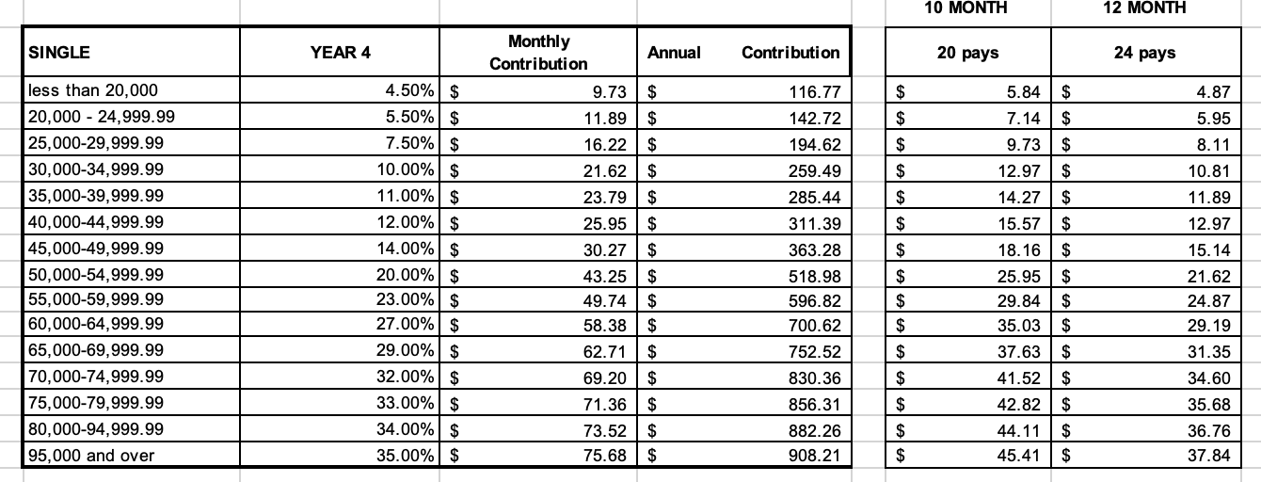
Hybrid Plan Single Coverage - $44.02 per pay
Staff member making $35,000 with single coverage pays 1.7% of pay:
$35,000*.017 = $595
$595/20 = $29.75 per paycheck
THEN you add the prescription contribution. $14.27 per paycheck
Compared to $67.22 per pay on Direct 15.
Savings of $23.20 per pay.
$464 per year

Slide 13
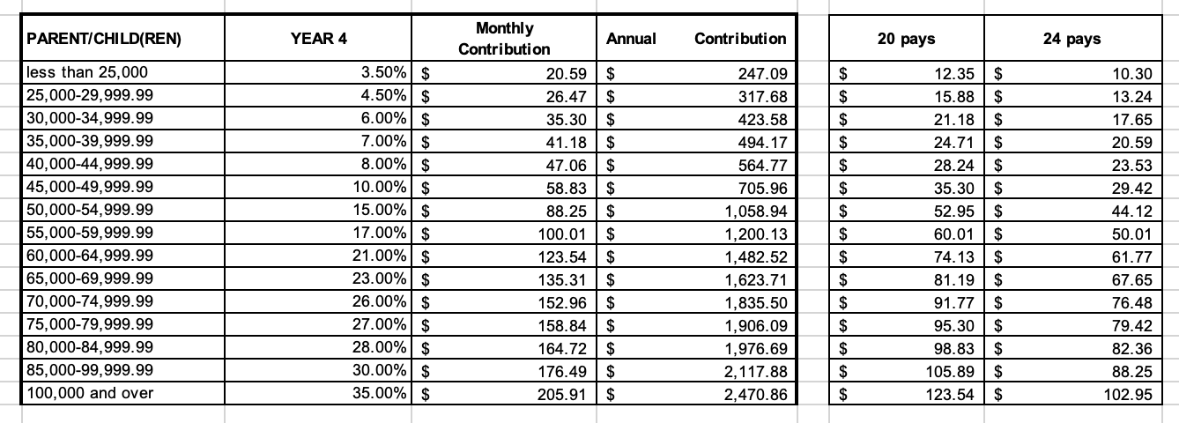
Hybrid Parent Child Coverage - $281.39 per pay.
Staff member making $90,000 with Parent/Child Coverage pays 3.9% of pay:
90,000*.039 = $3,510 yearly contribution
$3,510/20 = $175.50 per paycheck
THEN you add the prescription coverage. - $105.89 per paycheck
Compared to $346.75 per pay on Direct 15.
Savings of $65.36 per pay.
$1307.20 per year

Slide 14
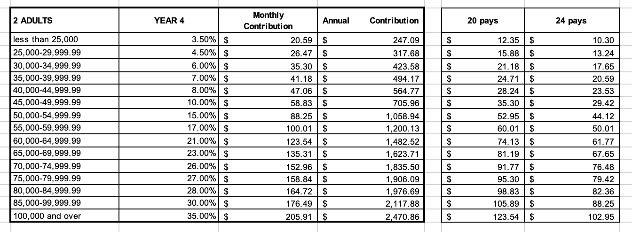
Hybrid 2 Adult Coverage - $224.89 per pay
Staff member making $65,000 with 2 Adult Coverage pays 4.4% of pay:
65,000*.044 = $2,860 yearly contribution
$2,860/20 = $143 per paycheck
THEN you add the prescription coverage. - $81.19 per paycheck
Compared to $330.71 per pay on Direct 15.
Savings of $105.82 per pay.
$2,116.4 per year

Slide 15
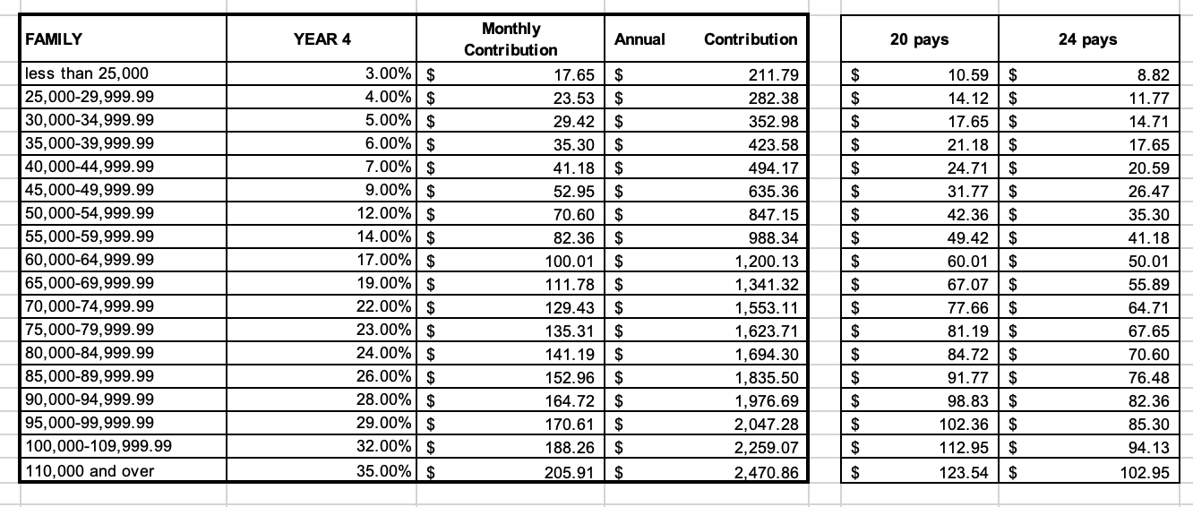
Hybrid Family Coverage - $287.44 per pay
Staff member making $75,000 with family coverage pays 5.5% of pay:
75,000*.055 = $4,125 yearly contribution
$4,125/20 = $206.25 per paycheck
THEN you add the prescription coverage. - $81.19 per paycheck
Compared to $393.09 per pay on Direct 15.
Savings of $105.65 per pay.
$2,113 per year

Slide 16
THE BEST PART
This is one of two open enrollment periods we have this year! If you decide to switch your plan and are unhappy with it, you can switch back again during open enrollment in October/November with an effective date of January 1!

